Slide 1
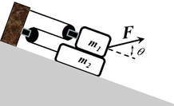
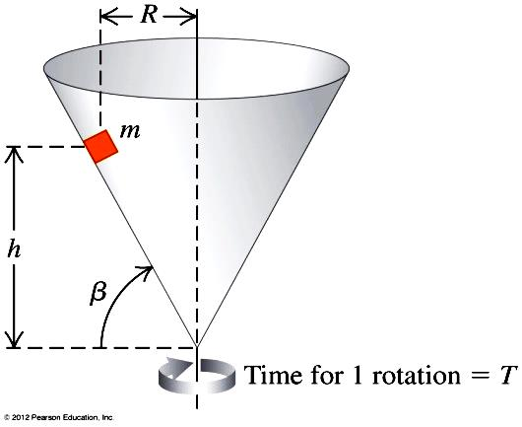
Homework 5
Due on 10/17/2018 for class meeting on Mon & Wed
Due on 10/20/2018 for class meeting on Tue & Thu
1. As shown in Fig.2, on the top of the inclined table which makes an angle ϕ with horizontal, a block with mass m₁ is placed on top of another block with mass m₂, and they are connected with a massless rope through the pulleys. The coefficient of the kinetic friction between all surfaces is μ. A constant force F is pulling block m₁ in the direction at an angle θ relative to inclined plane.
Fig. 2
φ
(a) List the all forces that act on block m₁ and those act on block m₂. Define a coordinate system for the system in Fig.2, and draw free body diagram of block m₁ and block m₂.
(b) Find the acceleration of block m₂.
(c) If the angle θ is adjustable, find the angle θ with which block m₂ has maximum acceleration.
2. A small block of mass m is placed insided an invertied core that is rotating about vertical axis such that the time for one revolution of the cone is T (Fig. 2). The static friction between the block and the inside surface of the cone is μ. Write your answers in terms of g, m, R, and h.
(a) Draw the free body diagram for the small block in this motion.
(b) Find the periods of the block, T =2πR/v = 2π/ω = 1/f , for (i) the friction force is zero, (ii)T is maxima and minima, to keep the block at distance h above the apex of the cone.
Fig. 3

Slide 2
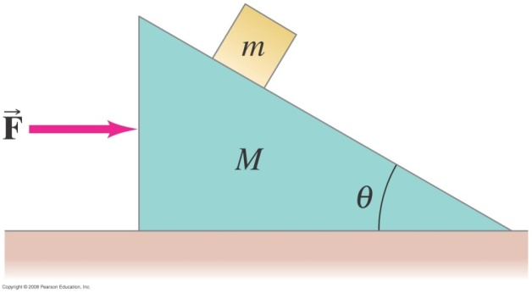

Problem 3； A small block of mass m rests on the sloping side of a wedge of mass M which itself rests on a horizontal frictionless table as shown in Fig. 2. (i) Now consider the coefficient of static friction is $μ$_{s} between the small block and the wedge (the table is still frictionless), draw the free-body diagram for each block and determine the maximum and minimum horizontal force F applied to M such that the small block m to remain at a constant height above the table. Assume M = 2m= 2 Kg, $μ$_{s} = 0.5, $μ$_{k} = 0.4, and tan θ = 1
(ii) If F = 10 mg, determine the acceleration of each block.
Fig. 3

Slide 3
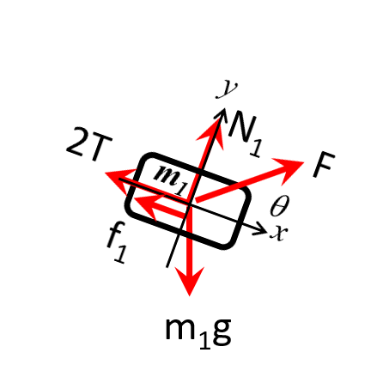
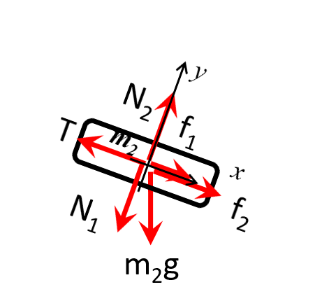







(a)
The forces which act on m₂ include
(1) Gravitational force m₂ g,
(2) Normal force N₁ from m₁,
(3) Normal force N₂ from table top,
(4) Tension of the rope T,
(5) Friction force f₁ from surface between m₁ and m₂,
(6) Friction force f₂ from surface between m₂ and table.
The forces which act on m₁ include
Gravitational force m₁g,
Normal force N₁ from m₂,
External Force F,
Tension of the rope 2T,
Friction force f₁ from surface between m₁ and m₂.
(b)
x:
y:
$m2gsin∅−T+f\text{2}+f1$=m₂a₂
x:
y:
Fcos$θ+m1gsin∅−2T−f1$=m₁a₁
$$N2−N1−m2gcos∅=0$$
Fsin$θ+N1−m1gcos∅=0$
$f2$=μN₂
$f1$=μN₁
$$constraint equation:a2=−2a1$$

Slide 4
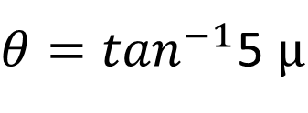


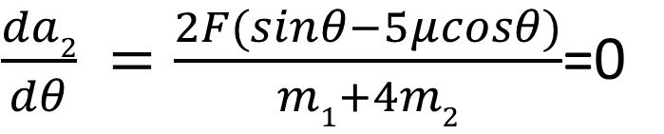
$$N1=m1gcos∅−\text{Fsin}θ$$
$$N2=N1+m2gcos∅=m1gcos∅−\text{Fsin}θ+m2gcos∅$$
$a_{2}$=$\frac{2[F\left(−cosθ−5μsinθ\right)+gsin∅\left(2m2−m1\right)+μgcos∅(5m1+2m2)]}{m1+4m2}$
(c)
$\frac{da2}{dθ} =\frac{2F(sinθ−5μcosθ)}{m1+4m2}$=0
$$tanθ=5μ$$
$θ=\tan^{−1}$5 $μ$

Slide 5
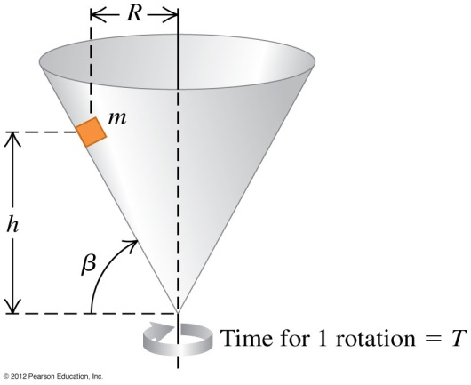
minimum:
maximum:
y
or
x

Slide 6




For Fmin
Sol:
$$N^{′}$$
對m
$$F$$
$$f\text{s}$$
y
θ
x
$$mg$$
（最大靜摩擦力）
(3)代入(1)與(2) 後，再求 (1)/(2) 即得
For Fmax
對m
f_{s} 反向， f_{s} ➔ - f_{s}
$$N^{′}$$
$$F$$
f_{s}
$$mg$$

Slide 7

(ii) F = 20mg > F_{max} ➔ m 往上移動
: acceleration of m relative to M ➔
: acceleration of M relative to ground (向右為正)
(1)
(2)
(3)
(1)/(2)➔
(4)
(1) ➔(3)
(5)
(5)*10 –(4)➔
地面看到 M 的加速度為
(向右)
地面看到 m 的加速度為
(向右),
(向上)

